Slide 1
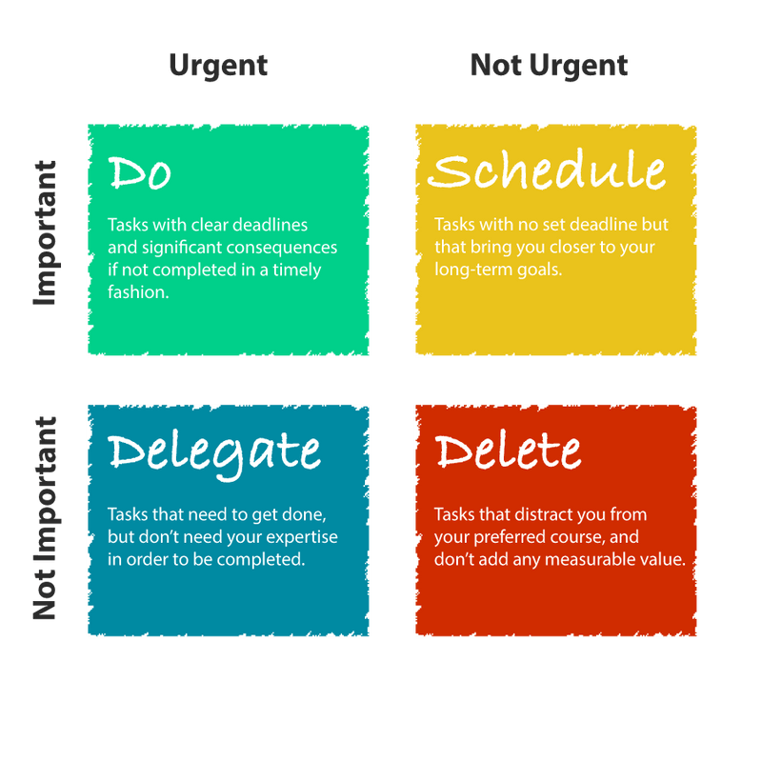
Draw the Urgent Important matrix

Slide 2
Name your goal within one year. Name three sub-goals that will allow you to achieve your primary goal:
GOAL:
Open my coding startup
SUB-GOALS:
Start with my youtube channel to make my skills notworthy
Make a client portfilio
Improve my leadership skills

